Slide 1
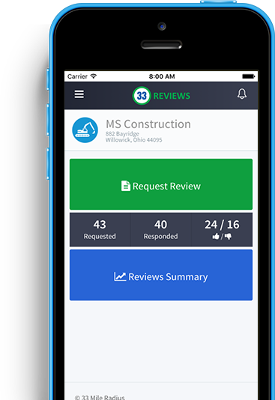
Acquirly Review Generation Setup and Overview

Slide 2
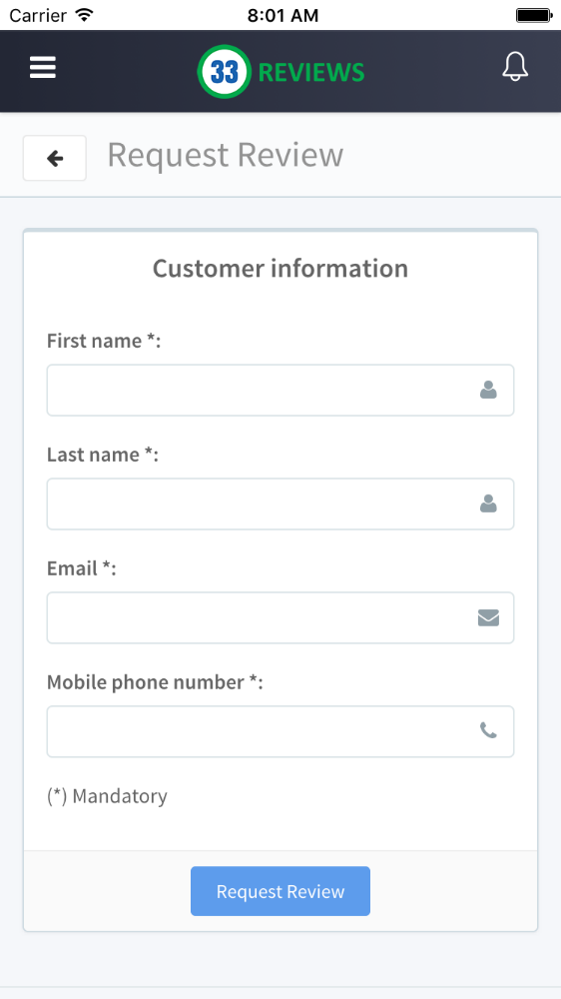
What Is Acquirly?
Acquirly is a mobile application that allows companies to get more reviews on online sites such as:
Google
Facebook
Yelp
Angies List

Slide 3
Why Are Reviews Important?
Reviews are now critical to get customers from the web
Great reviews increase the chance that someone will call or buy
Reviews are a positive signal to search engines that your company should be shown higher in the search results

Slide 4
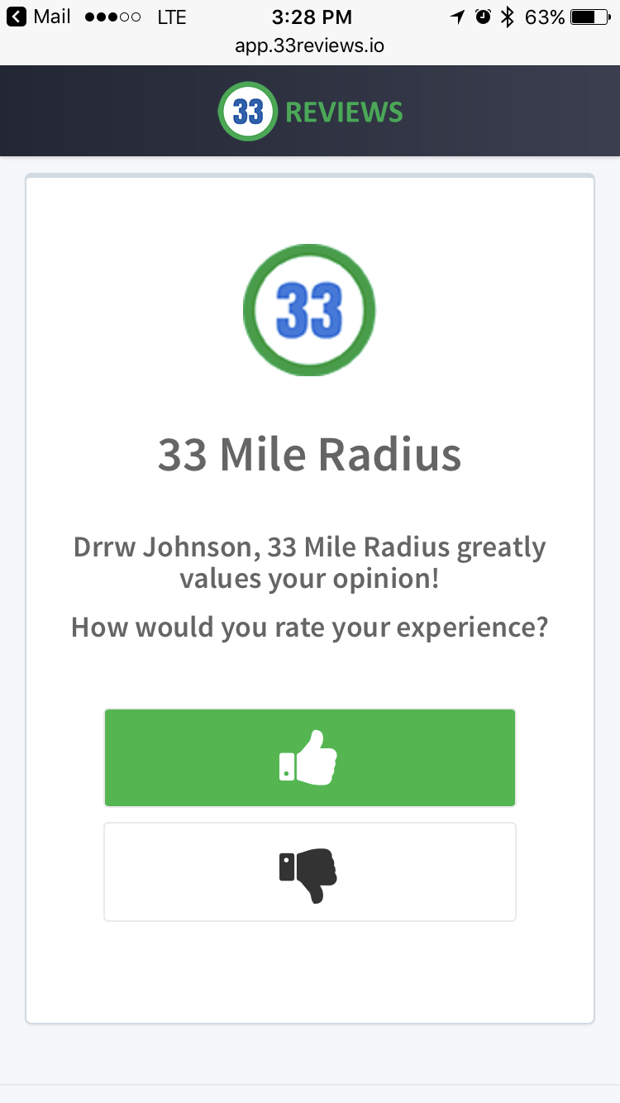
How it works
At the end of each job every customer will receive a link via email and text message. This link takes them to a page asking how the service was.
If bad the client will leave a thumbs down and be asked why the service was subpar

Slide 5
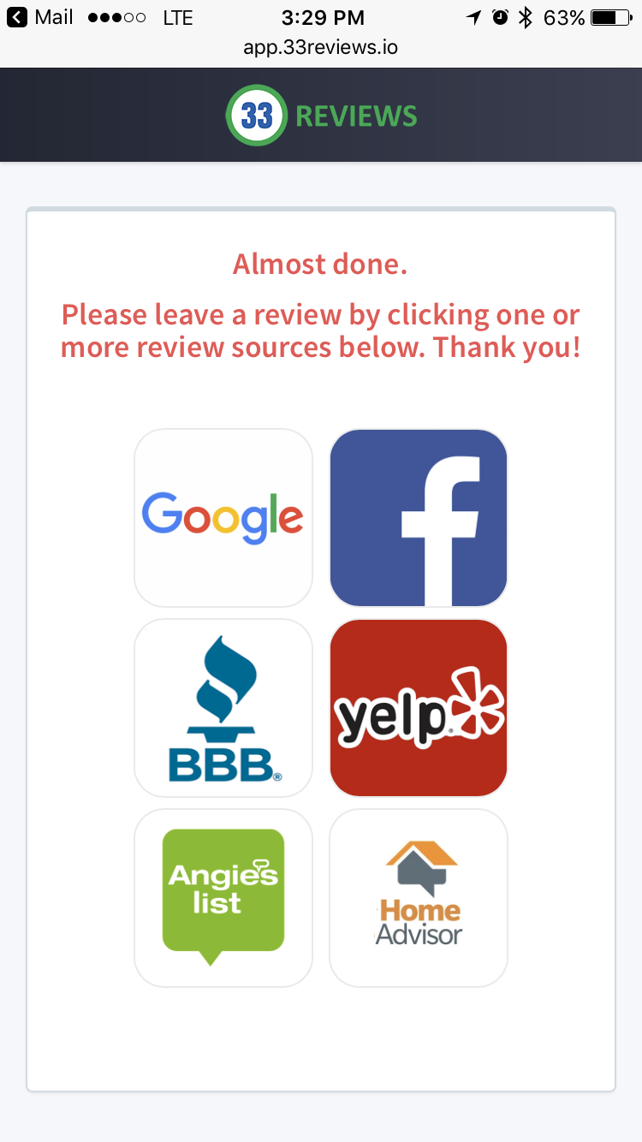
How it works
If the service was good the client will leave a thumbs up and be taken a to a page to then leave a review online

Slide 6
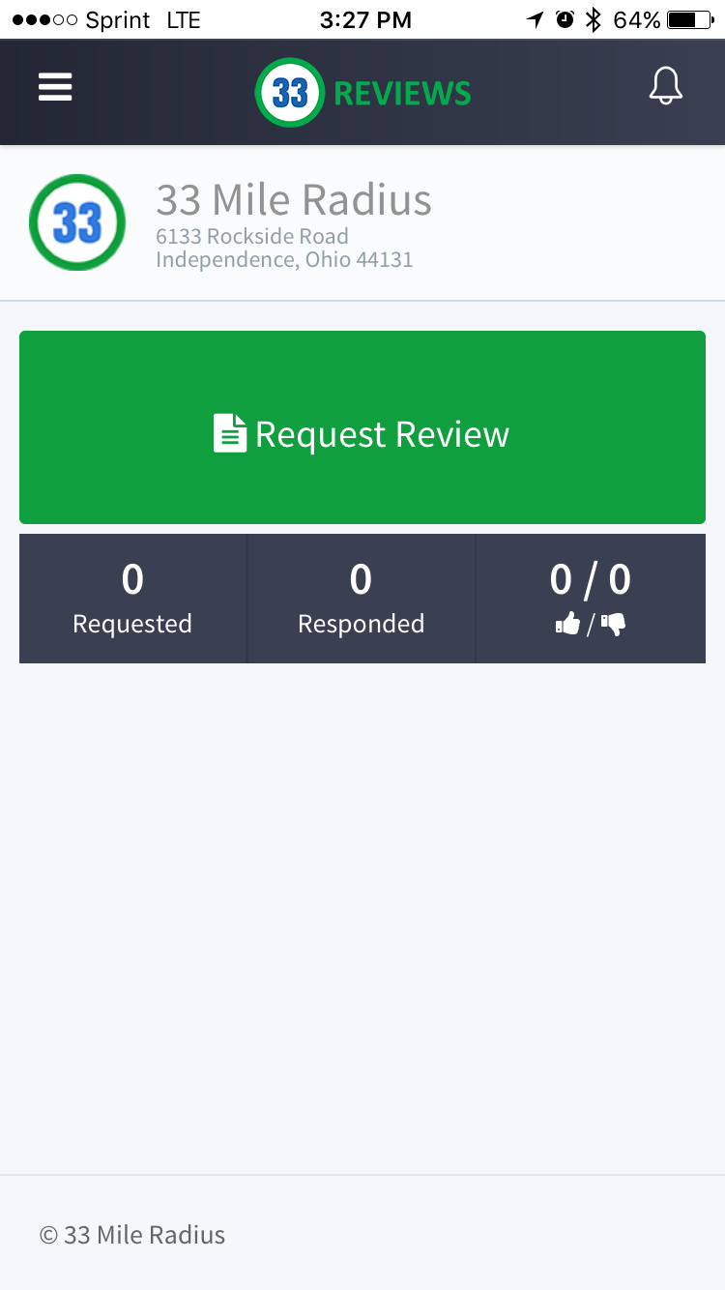
How to use the App
Getting a review takes 4 steps
After the job ask the customer if they will leave you a review.
If so, open the Acquirly App and press “Request Review”.

Slide 7
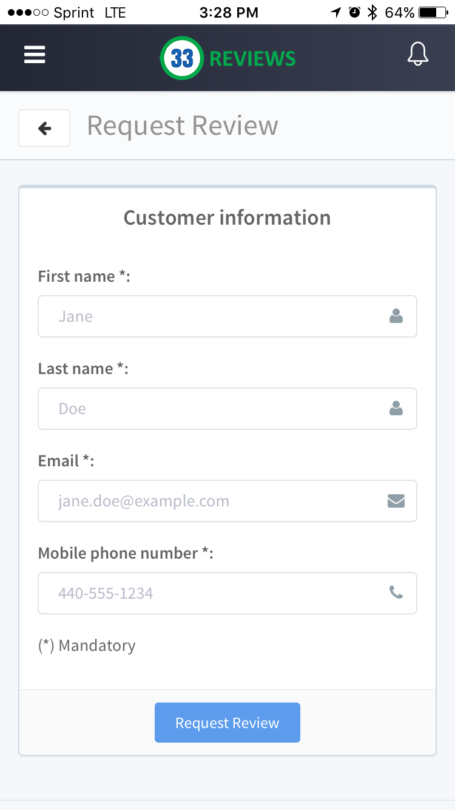
How to ask for a review
Enter the clients email and phone number
Confirm that the customer received the email and text and let them know if they need any help

Slide 8
How to ask for a review
How you ask for the review is the most important step in the process
People are more likely to help when they know the “why” behind it.
Explain that it will only take a few minutes and that it will help you and your business grow

Slide 9
Examples
Here are a few great ways to ask for a review once the job is completed:
Finally, I would like to ask you to leave a review of our service online. Do you have a few moments to write a review?
I want to thank you for using our company. One of the ways my boss grades me is through reviews; do you have a minute to leave me a review online? It is very simple, I can walk you through the entire process.
In order to make our service better, we appreciate honest feedback. We use a system online to capture this data. If you have a minute, I can walk you through the process.
We greatly appreciate you and value your opinion. To improve our services, would you leave us a review?
We greatly appreciate you and value your opinion. Would you take a minute to leave us a review?

Slide 10
More information
For more information check out our blog at http://www.33mileradius.com/blog/
And our resources page at http://www.33mileradius.com/resources/

